Slide 1
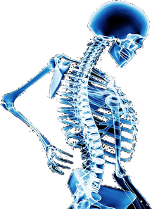
Skeletal Imaging
IN NUCLEAR MEDICINE

Slide 2
Required Reading
SNMMI Procedures Standard for Bone Scintigraphy 4.0
https://www.snmmi.org/ClinicalPractice/content.aspx?ItemNumber=6414#Skeletal
Information in the presentation follows the procedures standards set forth by SNMMI on bone scintigraphy
Please refer to these standards for further clarification on bone imaging procedures
Additional information can be found on numerous other procedures standards by SNMMI
https://www.snmmi.org/ClinicalPractice/content.aspx?ItemNumber=6414

Slide 3
PART I
In this section we will discuss
Anatomy and Physiology of the Skeletal system
MDP and the mechanism of uptake
Compounding MDP

Slide 4
Clinical Indications and Applications
Detect skeletal lesions at earliest possible time
Staging of skeletal disease
Evaluate metabolic activity of skeletal disease
Commonly used to image metastases (mets)
Primary cancer that has spread to another site

Slide 5
Studies
Bone Imaging
Whole Body Bone Imaging
Three-Phase Bone Imaging
For the assessment of osteomyelitis

Slide 6
Why Utilize a Bone Scan?
High sensitivity compared to other modalities
Ability to detect when something is wrong
30-50% of the bone must be decalcified before tumors or infection can be detected with x-rays
Bone Scan only requires 1 – 2% (~15%) decalcification to yield abnormal bone scan
Issue – there is low specificity
Ability to identify a specific disease state
Example is it a fracture or is it metastatic disease?

Slide 7
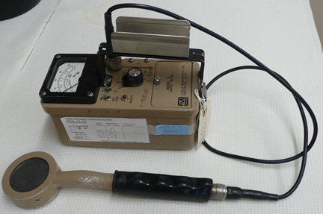
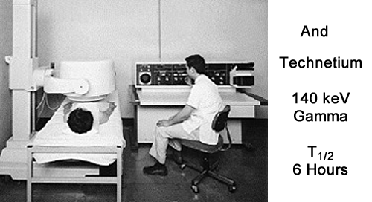
A little History of the Radiopharmaceuticals
7
First attempts – ³²P and ⁴⁵Ca (Pure Beta)
Then came the mix emitters – ⁴⁷Ca and ⁸⁵Sr and ^{87m}Sr
Energies where 1.3 meV, 513 keV and 388 keV
T_{1/2} 65 days to 2.9 days
Revolution in imaging and radiopharmaceuticals
^{99m}TcPYP/PYR
Diphosphonates – ^{99m}TcMDP/HDP
Resurgence of Na¹⁸F (PET)

Slide 8
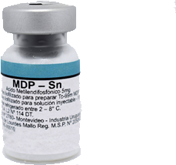
Primary Radiopharmaceutical Used in Bone Imaging
^{99m}Tc MDP
Medronate (brand)
Methylene diphosphantic acid (generic)

Slide 9
What is the composition of Bone Tissue?
Approximately 30% organic and 70% inorganic
90 to 95% of organic bone is made up of collagen and mucopolysaccharides
Majority of bone is inorganic. This crystalline structure is also referred to as : boney matrix or the hydroxyapatite
It is composed of calcium, phosphorus (mostly found as phosphate)
To a lesser amount – sodium, magnesium, potassium, chloride, and fluorine
Bone tissue is similar to and associated with connective tissue
While bone consists of living tissue the predominant amount is non-living bone has been calcified.

Slide 10
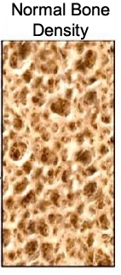
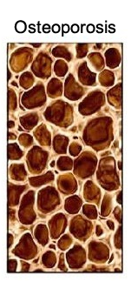
Factors that Affect Bone Development
Nutritional needs include calcium, protein, magnesium, phosphorus, vitamin D, Fluoride, potassium
Exposure to sunlight creates Vitamin D for bone development
Physical exercise causes bone tissue to develop and become denser/stonger
Hormonal secretions – refer to the next slide

Slide 11
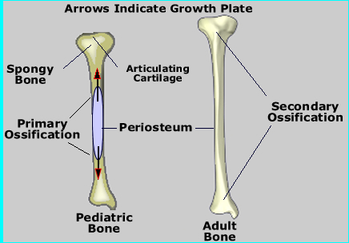
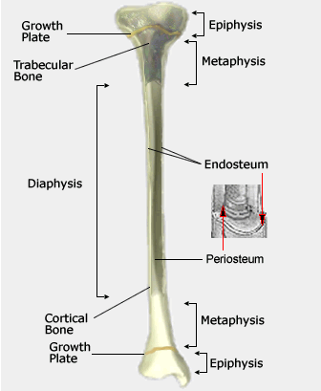
Hormonal secretions and Bone Growth
Stimulate activity in the epiphyseal (growth) plates via
Growth Hormone-1 stimulate formation/absorption
Parathyroid hormone to regulate calcium levels and growth
Estrogen and testosterone assist in strengthening bone
Pediatrics bone development
Cartilage/soft bone undergo primary ossification at the epiphyseal plate
The diaphysis is “left behind” where osteoblastic cells ossify the organic tissue

Slide 12
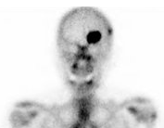
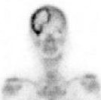
Bone Lesions have Increase or Decreased Activity
Increased concentration of radiopharmaceutical is commonly osteoblastic activity (this is more common)
Decreased concentration of radiopharmaceutical is commonly osteoclastic activity (e.g. lytic lesion)
https://www.sciencephoto.com/media/934626/view/metastatic-renal-cell-carcinoma-bone-scan
https://www.researchgate.net/publication/273278778_Prolonged_survival_in_a_patient_with_isolated_skull_recurrence_of_cervical_carcinoma_-_Case_report_and_review_of_the_literature/figures?lo=1

Slide 13
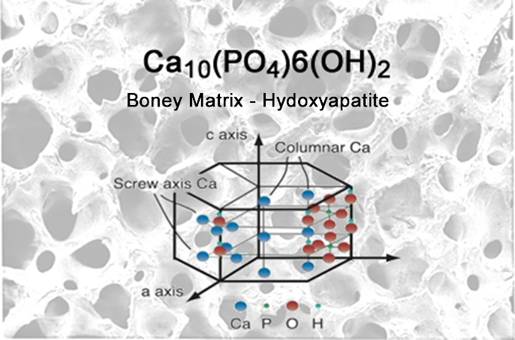
Hydroxyapatite Crystal
Inorganic constituent of bone matrix and teeth
Forms lattice structure composed of calcium, phosphate and hydroxyl ions
Strength and density

Slide 14
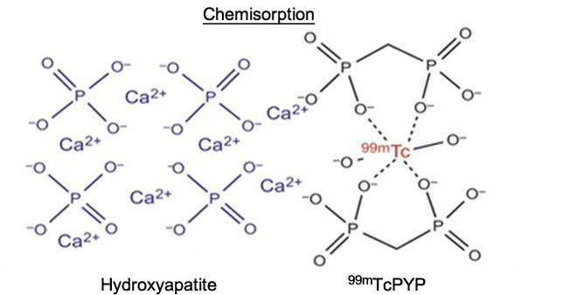
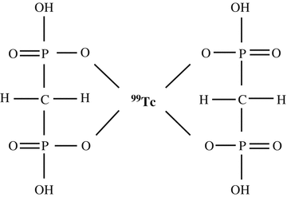
Continuous interchange of ions between crystal lattice and the fluid that bathes it
RP localizes in the hydroxyapatite (HA) crystal via adsorption and ion exchange (chemisorption)
Specifically any phosphate exchanges with calcium on the HA cystal
99mTcMDP, 99mTcHDP, 99mTcPYP,

Slide 15
Radiopharmaceutical - Mechanism of Localization
Chemisorption
Bone tissue is comprised of organic and inorganic substances. The inorganic portion (bone matrix) consists of hydroxyapatite crystals that are composed of calcium, phosphate, and other mineral components
Localization of the imaging agent is through the exchange of ions native to the bone tissue with ions from our labeled radiopharmaceutical

Slide 16
Mechanism of Localization
Calcium phosphate is a main component of bone tissue
When a bone is injured or affected by a disease process, calcium phosphate will go to the site to repair and build new bone
Radiolabeled phosphate compounds will undergo ion exchange at these sites through chemisorption
Two major factors control accumulation of phosphates in bone
1) Blood flow - skeletal vascularity
2) Extraction efficiency
Rate of new bone formation (Osteoblastic activity)
↓ Decreased uptake will occur in
Impaired or no blood flow (bone infarct)
Complete destruction (AVN- avascular necrosis)
Abscesses
Replacement by benign tumor

Slide 17
Other areas of Radiopharmaceutical Accumulation
Factors that effect MDP uptake
Soft tissue uptake
Renal impairment
Decreased cardiac output
Dehydration
Extravasation of the radiopharmaceutical
Aging
Under dosage of radiopharmaceutical
Obesity

Slide 18
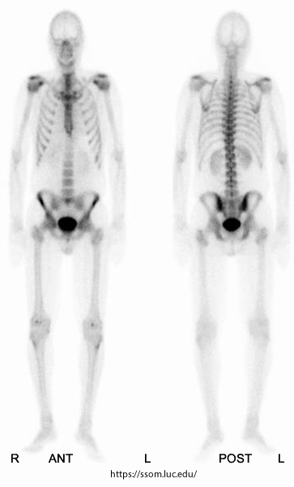
Normal Skeletal Uptake
Uptake of the radiopharmaceutical is symmetrical
Normal uptake
Sacroiliac joints
Hip joints
Glenoid fossa
Acromioclavicular joints
Sternoclavicular joints
Ends of long bones
Growing epiphyses - pediactric
Vertebral column

Slide 19
MDP Kit Contains
Medronic Acid (ligand)
Stannous Chloride Dihydrate or Stannous Fluoride (reduces valence from +7 to +4)
Antioxidant, such as ascorbic acid (depends on manufacturer)
Introduction of oxygen into the kit will reduce the tagging by increasing the amount of free tech
ALL RPs have sodium hydroxide and/or hydrochloric acid in them for pH adjustment

Slide 20
MDP Kit Preparation
Add the pertechnetate
The maximum activity is set by the manufacturer
DraxImage has a max of 500 mCi in 2 mL to 10 mL
Saline may be added when compounding
Do not inject air into the vial – this may break down the tagged compound
Mix for 1-2 minutes by swirling the vial
Store at 20-25 ºC before and after compounding
Expires in 6 hours
For more information on compounding see package insert - https://www.accessdata.fda.gov/drugsatfda_docs/label/2011/018035s032lbl.pdf

Slide 21
Part II
Bone Procedures
Administration and Patient Preparation
Patient Positioning
Three Phase Bone Scan
Limited Bone Scan
Pinhole Imaging
SPECT Bone
Other Spot views
May perform all four on the same patient

Slide 22
Administration
10-30 mCi (370 MBq – 1.11 GBq) dose for both MDP
Unless otherwise indicated this is the standard dose range for all bone imaging procedures
Method of Administration - IV bolus
For three-phase bone scan, injection must occur while on gamma camera to visualize blood flow of radiopharmaceutical
Immediately when injecting dynamic blood flow
Immediately following phase 1, static blood pool
Delay 3 hour skeletal imaging

Slide 23
Post Administration
Begin imaging 2-3 hours post injection
In normal radiotracer distribution approximately three hours after injection you will have 50% of the activity seen in the skeleton
The other 50% will be excreted through the kidneys

Slide 24
Patient Preparation
Patient may eat or drink as normal
After administration of radiopharmaceutical, the patient must wait 2-3 hours before imaging
This is to allow the radiopharmaceutical to collect in the bone and to reduce the amount of background activity in the soft tissue which is eliminated through the kidneys

Slide 25
Patient Preparation
Instruct the patient to drink 6-8 glasses of a liquid (1 liter or more). This will help to concentrate the radiopharmaceutical into the bone and not the soft tissue
Soft tissue uptake can increase with poor renal function or dehydration
To reduce the radiation burden to the bladder tell the patient to urinate often
Just prior to image acquisition have the patient void – A radioactive urinary bladder can mask bone lesion in that vicinity

Slide 26
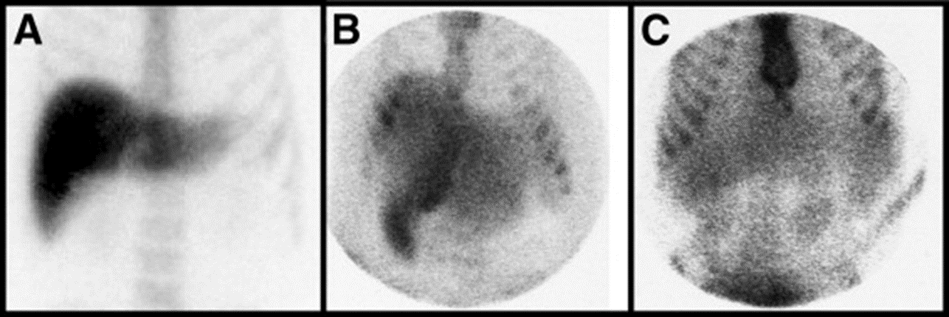
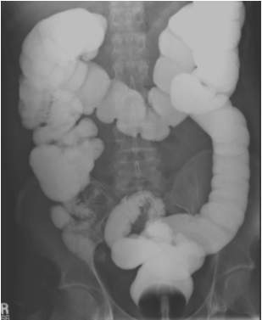
Contraindications
Colloidal formation from the drug interaction
Recent Tc^{99m} study (24-48 hours)
Barium contrast may cause attenuation
Barium Contrast

Slide 27
Normal Skeletal Uptake
Uptake of the radiopharmaceutical is symmetrical
Normal uptake
Sacroiliac joints
Hip joints
Glenoid fossa
Acromioclavicular joints
Sternoclavicular joints
Ends of long bones
Growing epiphyses - pediactric
Vertebral column

Slide 28
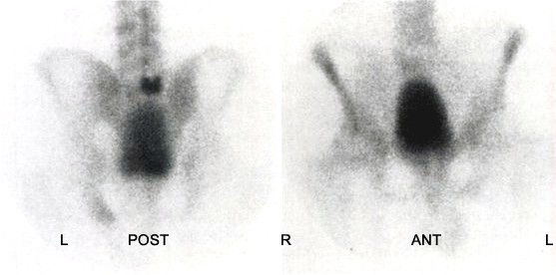
Patient Positioning
Clothes are no problem
Void and remove attenuators
Prostate CA
Patient that cannot eliminate most of their urine may require catheterization. Concern – masking mets in the pelvic

Slide 29
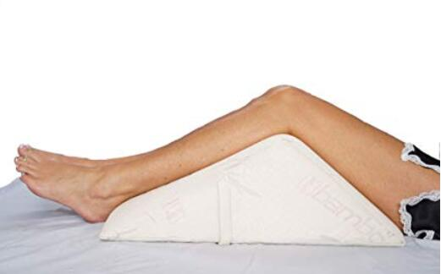
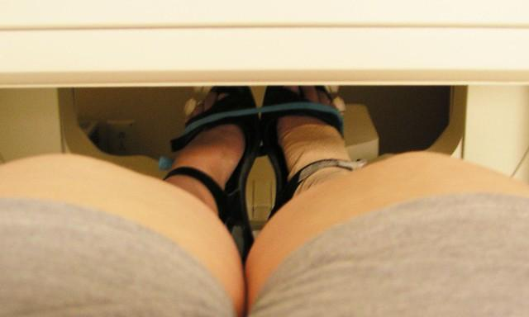
Patient Positioning
Make the patient comfortable.
Pillow for head support
Pillow under knees – improves lumbar curvature
Patient must hold still
Foot band to line up joints for A/P acquisition
https://pillowreviewer.com/
https://www.flickr.com/

Slide 30
Three Phase Bone Scan
Bone scan with flow, capable of detecting:
Infection
Stress fracture (fx)
Avascular necrosis (AVN)
Vascularity of lesion
Osteomyelitis
Cellulitis

Slide 31
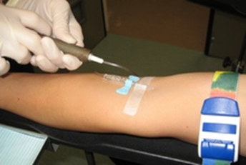
Phase 1 – Blood flow
Include both ROI and contra-lateral in FOV
Bolus injection
At a 64 x 64 or 128 by 128 matrix immediately record dynamic flow images every 2-4 seconds for 60 seconds
Vascular flow to area

Slide 32
Phase II – Tissue/Blood pooling
Blood pools or immediate statics
Same position as flow
To be performed immediately following the flow
500k count statics or 3-5 minutes (256 x 256 matrix)
Soft tissue phase - Perfusion in area
Sometimes referred to as
“immediate” images
Complete within 10 minutes post injection

Slide 33
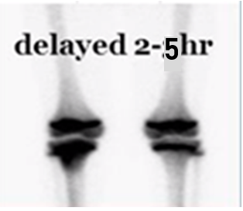
Phase III – Delay/Bone activity
Routine bone scan – patient returns 2-3 hours post dose – Spots views are usually taken, but whole body may be considered
Spot view
Matrix size 256 x 256
Low Energy Parallel Whole collimator
Acquisition 3-500k or 5 minute is
acceptable for the appendages
Delay phase - Bone metabolism
Follow the same setting for spot view
SNMMI Procedure Standard for Bone Scintigraphy 4.0
- Refer to procedures guideline for more detail

Slide 34
Cellulitis
Activity shows increased uptake on flow (A) and immediate static (B), but there is “normal“ issue uptake in the delays ©
Hyperaemia (also hyperemia) - is the increase of blood flow to different tissues in the body. It can have medical implications but is also a regulatory response, allowing change in blood supply to different tissues through vasodilation.
https://www.researchgate.net/figure/Example-images-of-cellulitis-arrows-Significant-uptake-of-99m-Tc-MDP-is-seen-in-left_fig2_51526933

Slide 35
Phase Four
On a rare occasion a fourth phase maybe required
This occurs when there is excessive background activity
Images may be requested for up to 24 hours post inject
Cause
Renal insufficiency
Diabetic
Cellulitis vs Osteomyelitis (image D is 24 hours)
Spot imaging only of ROI at 24 hours
Do to the lack of activity imaging acquisition may set for 20 minutes instead of counts

Slide 36
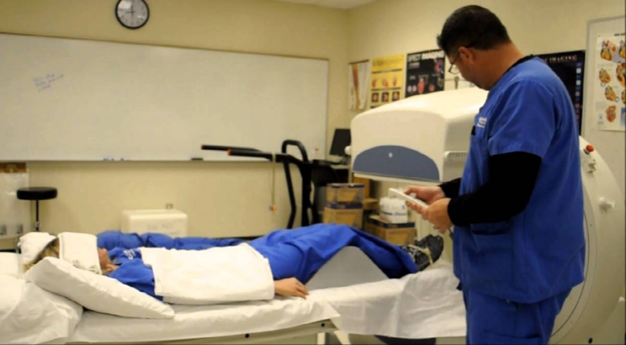
Whole Body Bone Scan (WBB)
Most common skeletal procedure
Inject IV
Scan 2-4 hours post injection
Camera
256 x 1024 Matrix
Low Energy Parallel Whole (LEPH)
Scan speed 16 cm or less
Supine on table
Knee pillow
Binder or band around feet/toes
SNMMI Procedure Standard for Bone Scintigraphy 4.0
- Refer to procedures guideline for more detail

Slide 37
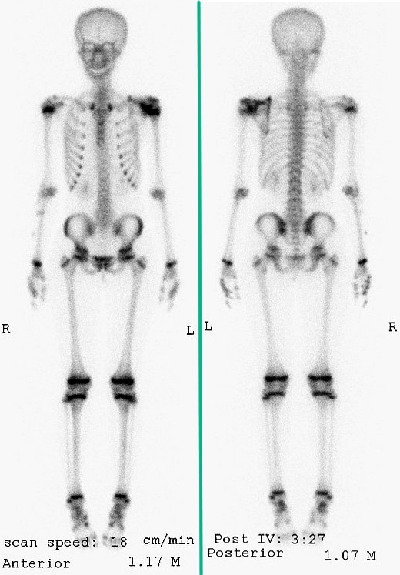
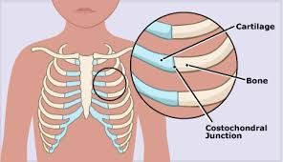
Label the Scan – Ant/Post – L/R
Normal pediatric bone scan increased radiotracer activity in the epiphysis (growth plates)
Growth Center
Constochondral junction
Most intense
-proximal humorous
-distal femur
-proximal tibia
Costochondral junctions
https://radiopaedia.org/

Slide 38
Whole Body Bone - continue
Always place camera as close as possible to the patient
Use whole body contouring if available
Acquire spots if needed
Spot views
256 x 256 Matrix
Suggest - 500k to 1000k image at axial skeleton and then preset the time
Notes:
TAKE TIME TO USE CAMERA LAB

Slide 39
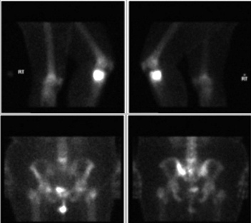
Limited Bone Scan
Usually several spot views
Similar to a three-phase bone, but without the first two phases
Study with limited views of skeleton
Spot views
256 x 256 Matrix
LEPH
Suggest - 500k to 1000k image at axial
skeleton and then preset the time
Remember the body is bilaterally
Symmetrical – always include the
contra lateral side
https://radiologykey.com/identifying-bone-metastases/

Slide 40
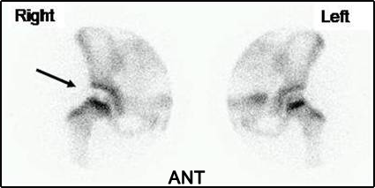
Limited Bone Scan - Pinhole
On a rare occasion a pinhole image is required
Gives very high resolution images
Assess greater detail
May be used in infants, pediatric, and small structures
Acquisition parameters
75 – 100k images
Apply zoom if necessary
https://numebook.cl/artmes/NMDigitalBook/Skeletal/ANpertes.htm

Slide 41
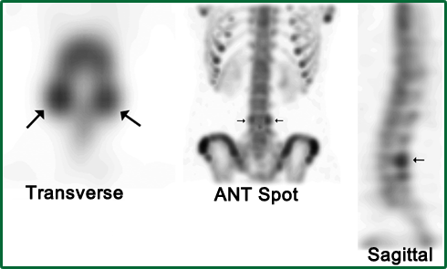
Single Photon Emission Tomography SPECT
May help to identify the presence of disease and location
Best applied where there is overlapping bone with questionable disease
Ex. WBB identifies questionable uptake in a vertebral body
SPECT is order better identify the presence and location of disease
Image contrast is improved
Spatial resolution is not, whoever depth information is revealed
Positioning is critical

Slide 42
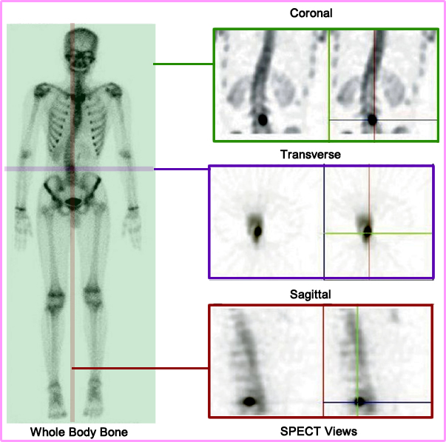
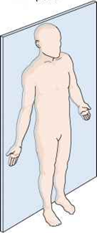
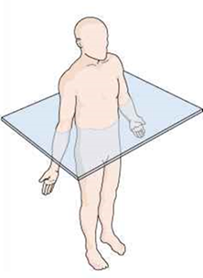
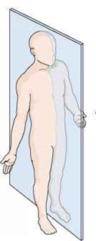
Normal SPECT Bone and Whole Body
Coronal
Transverse
Sagittal

Slide 43
SPECT Continues
Acquisition Parameters
360⁰ rotation – elliptical or body contouring preferred
Two headed camera preferred
Spots 60 to 120
Matrix 64 x 64
10 to 40 seconds per stop
The greater the time per stop the greater the count
Rule of thumb – Acquisition time should never be more than 30 minutes
Concern for patient movement
SPECT Processing
See manufacturers/software guidelines for processing.
Integral and differential uniformity should be < 3.0
Center of Rotation (COR) should be done weekly
Variation should be <0.5 pixel
Suggested filters
Hanning and Butterworth to liminate high frequencies
Ramp to eliminate low frequencies
Pre/post image smoothing may be required

Slide 44
Tail on Detector
Acromion Process
Views, Projections, and Artifacts
Lateral, Plantar, and Palmar

Slide 45
Tail on Detector (TOD)

Slide 46
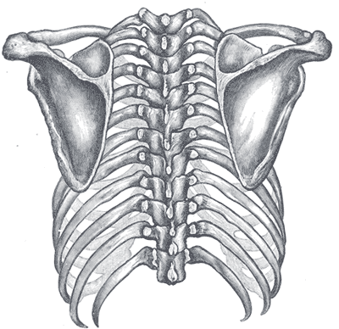
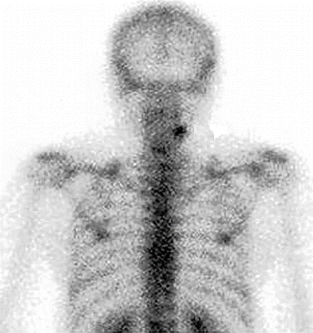
Acromion Process
Tip of scapula overlying rib
Hot spot is a cervical osteophyte
https://pubs.rsna.org/doi/10.1148/rg.232025103

Slide 47
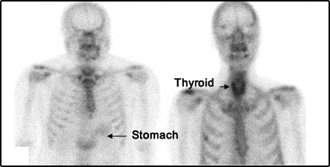
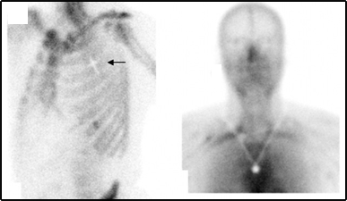
Views/Projections/Angles and artifacts
Spot view reviews free pertechnetate
That accumulates in the stomach and
thyroid
Attenuation defect – Have the patient
Remove all jewelry
https://med.emory.edu/

Slide 48
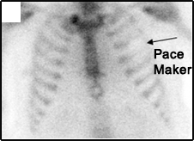
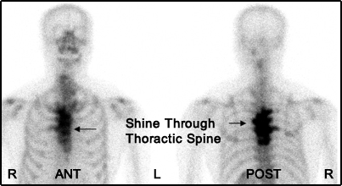
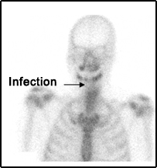
Views/Projections/Angles and artifacts
https://med.emory.edu/

Slide 49
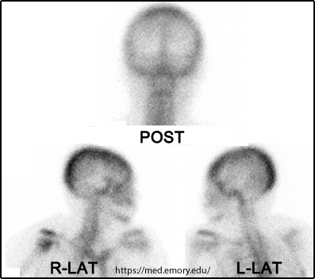
Lateral Skull

Slide 50
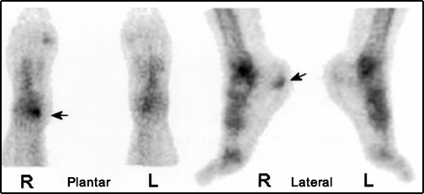
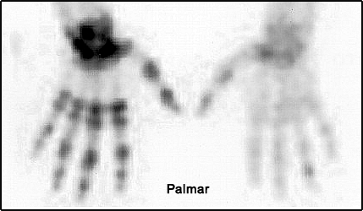
Plantar/Lateral/Palmar
https://pubs.rsna.org/doi/10.1148/rg.232025103

Slide 51
Part III
Technical Considerations
Contrast Enhancement
Collimation
Scan Speed
Matrix size
PHA and Windowing
Pitfalls in Tagging
Size
Age

Slide 52
Contrast Enhancement
Setting the gray scale in normal contrast is 0 to 100%
Adjusting the scale 0 to 80% translates to pixels counts that are between 80% to 100% all equal 100%
Does it hide the lesion on the top of the skull?
Adjust the gray scale 20 to 100% translates to all pixels between 0 to 20% have zero counts
How does this effect rib uptake
Key – Adjusting contrast can have a negative consequence

Slide 53
Contrast – Inverse
How do you display your images?
Black on White or white on black?
Adjusting the gray scale in this manner may improve image contrast

Slide 54
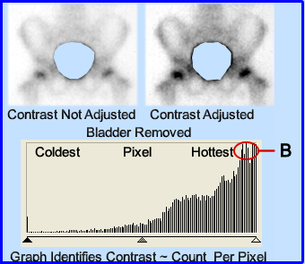
Contrast – Removing the Hottest Pixel
Computer identifies the hottest pixel and in this case it is the urinary bladder - A
Adjusting the image contrast has NO effect
Draw an ROI around the bladder and remove and cut out the unwanted activity - B
Now image contrast can be adjusted to since the hottest counts occur in the bone

Slide 55
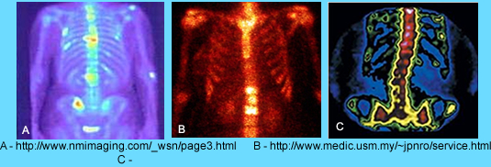
Contrast – Color Scale
Gray scale set to 256 has 256 shades of gray
Adding color adds to image contrast
Applying all color- Red, Green, Blue = 265³ shades of contrast
Three examples of different color scales applied to a bone scan
What do you find acceptable?
Key – adding color(s) adds greater variability with contrast. Does this always improve image contrast?

Slide 56
WB contouring
WB does improve image contrast and resolution.
The closer the detector is to the patient the less scatter is acquired
The greater amount of true counts are collected
If the body contouring mechanism fails. The adjustment of detector distance can be done manually

Slide 57
Factors Affecting Bone Images
Amount of scatter effected by:
Patient size
Larger patients have increased scatter
Increased organ / detector distance
Increase in gamma absorption by tissues
Images degraded because gammas never reach detector

Slide 58
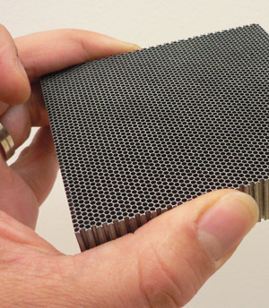
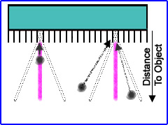
Collimation and Septa
Collimators are composed of lead septa and are usually designed to be parallel to each other
Gamma-rays that fall within the septa’s penumbra are collected and accepted as counts
Gamma-rays are outside the penumbra run into lead and are either absorbed or loose enough energy that the imaging system rejects the lower energy photon via the pulse height analyzer

Slide 59
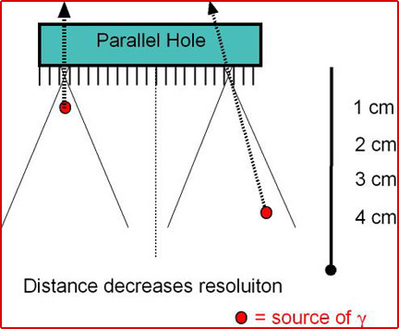
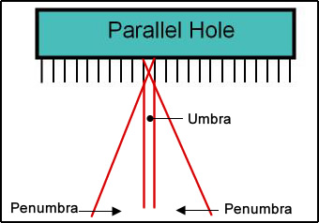
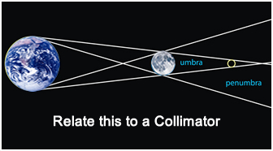
Applying Collimator Design
The goal of a collimator is to bring in as many true counts as possible
True counts accepted in the area of interest occur in the area of the Umbra
Ideally only those counts coming from the umbra are counts coming from the correct location of the gamma event
Scatter counts originate inside the penumbra and are recorded
Important concept
The closer the detector is to the patient the less scatter. This improves image contrast
The further away the detector is from the patient the greater the scatter counts. This has a negative effect on image contrast/resolution

Slide 60
Types of Parallel Whole Collimators
Length of the septa
General All Purpose (GAP) is a trade off between bringing in all count within the penumbra, therefore increasing count density
At issue is that this larger penumbra brings in greater scatter counts negatively impacting image resolution
Most NMT departments have a High Resolution (HR) collimators
Is the most common (LEHR) collimator utilized in an NMT department
Significantly reduces scatter counts
Ultra High Resolution (UHR) further improves spatial and contrast resolution by eliminating more scatter counts

Slide 61
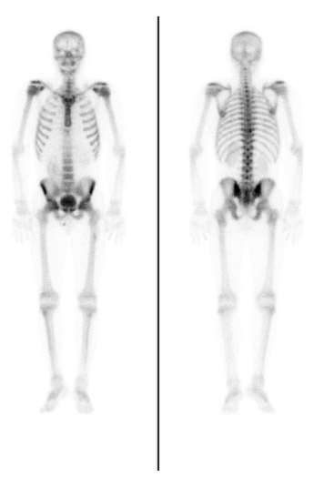
WB Bone and Scan Speed
Suggested scan speed for WB bone ranges between 8 to 15 cm per minute (ACR)
The slower your scan speed
The greater your count density and the better the resolution
Negative – greater the possibility of patient motion
The faster the scan speed
The lower your count density with a loss in resolution
Positive – less probability for patient movement
Goal – Assess patient tolerance and go as slow as you can

Slide 62
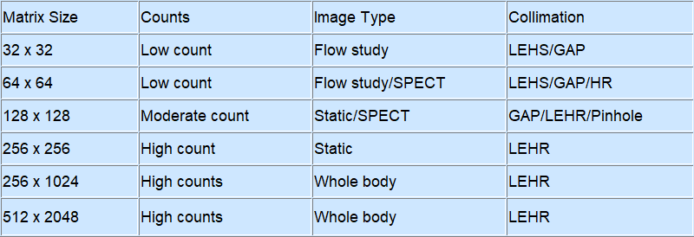
Matrix
An image is composed picture elements = Pixels
In NM a pixels contain counts
The greater the counts the greater the pixel density
The more pixels and counts there are the better the spatial resolution
Matrix size, pixels, and imaging
A 64 x 64 matrix contains 4096 pixels – less resolution
256 x 256 matrix contains 65536 pixels – greater resolution
The following image is the relationship a between collimation and matrix size – as suggested by this author
Variation may apply

Slide 63
Examples of Different Matrix Sizes
https://radiologykey.com

Slide 64
Pulse Height Analyzer and Windowing
PHA is usually set at 20% based on the energy of the incoming game
140 keV x 0.2 = 28 kev ÷ 2 = ±14 keV
Lower Lever Discriminator (LLD) = 126 keV
Upper Lever Discriminator (ULD) - 154 keV
Only those photons that fall within the window are accepted
Below the LLD are rejected
Above the ULD are rejected

Slide 65
Effects of PHA displacement
The images on display are of a flood field uniformity test.
Uniformity of the system is lost if
The 20% is center left of peak
The 20% is center right of peak
Conclusion – Misplacement of the energy peak will cause image distortion
Generating cold or hot artifacts

Slide 66
Pitfall with Tagging MDP
Poor tag of the radiopharmaceutical can generate too much free ^{99m}Tc pertechnetate
This can be an issue with the manufacturer via a production problem or
Re-oxidation of ^{99m}Tc by injecting air into the MDP vial. O₂ in the air causes the tag to breakdown
Free pertechnetate is notice by
Stomach, thyroid, salivary uptake uptake
Increase in soft-tissue
https://link.springer.com/chapter/10.1007/978-3-662-44169-5_4

Slide 67
Pertechnetate Scan
Without an MDP on board this image shows you the distribution of free pertechnetate
Salivary
Stomach
Thyroid
Kidneys (not seen)
Urinary bladder

Slide 68
Factors Affecting Bone Images
Effects of increased body attenuation
Example 1 – 85 kg male
Example 2 – 125 kg male
Increase in body mass increases
Attenuation of the gamma photon
Increases the distance between detector and patient

Slide 69
Patient age affects image
Infant to 21 years of age
Growth plates
Cartilage appears hotter
Twenty-one to ~60 years
High quality bone scan unless the patient is overweight or has renal disease
Sixty-plus
Reduced bone uptake due to decrease in bone density
Focal areas of uptake do to arterial calcifications and/or arthritis

Slide 70
Part IV
Diagnostic Potential Application of Non-Cancerous Bone Diseases

Slide 71
Intra-arterial Injection
↑ increased concentration of activity in blood flow to those bones caused by arterial delivery of the radiotracer
Referred to as the Glove Effect

Slide 72
Dental – Infection vs Primary bone Ca
72
Image on the right is osteomyelitis that occurred post tooth extraction
Image on the right is osteosarcoma of the left maxilla
While there is a difference in uptake intensity, it would appear difficult to differentiate disease
This is a good example of why it is so important to take a complete patient history
https://pubmed.ncbi.nlm.nih.gov/12521065/

Slide 73
Bone Graft
Initial assessment of bone a bone graft can be misleading
One week post activity is usually intense, but appears to show viable bone tissue
Excessive “trauma” to the bone makes it difficult to evaluate viability
One month post graft activity in the same area shows lack of bone uptake indicating failure.
https://onlinelibrary.wiley.com/doi/abs/
10.1034/j.1399-0020.2000.290410.x

Slide 74
Ascites
At times ascites may contain 99mTcMDP and can also be related to some type of carcinoma
This is an example of a patient that has peritoneal carcinomatosis from an unknown primary
CT shows significant fluid build-up which is also reflected in the WWB scan
https://www.sciencedirect.com/science/article/pii/S0001299814000671

Slide 75
Medallion Effect
Sternoclavicular joints
distal portion of manubrium photopenic - "medallion effect"

Slide 76
Surgical Wound and Fracture
Recent or healing surgical wounds / fx may have ↑ increased uptake

Slide 77
Breast Uptake / Shadow
Breast activity or Shadow may appear in a bone scan
Increased uptake or breast shadow may be due to
Lactation
Calcification
Mild soft-tissue uptake
Breast shadow may also be noted, however, an example is not given

Slide 78
Incidental Findings
Three hours post injection of ^{99m}TcMDP yielded the following image defining bilateral uptake of the pectoralis muscle
It appears that the patient had a extensive workout 48 hours prior to this bone scan
Extreme stress on muscle may cause trauma causing uptake of this radiotracer
https://journals.lww.com/nuclearmed/Fulltext/2004/12000/

Slide 79
Renal Imaging in a Bone Scan
Sometimes this is a serendipitous finding – R/O renal disease
Example 1 – Renals appear to be excreting very little radio-urine
Suggest a diuretic to see if there is a blockage, which was not done on this patient
Example 2 – Dilated ureters are identified and may be an indication of partial obstruction

Slide 80
Processing – Inflammatory Sacroiliitis
Draw region 1 around the hottest area of the sacroiliac joint
Draw region 2 around then midpoint of the sacrum
Region 1 ÷ Region 2
1.1 to 1.55 Normal
1.55 to 1.75 Equivocal
>1.75 inflammatory sacroiliitis

Slide 81
Osteomyelitis
Need to distinguish from cellulitis and osteomyelitis
Cellulitis - short term antibiotics
Osteomyelitis - long term (>6 months) expensive antibiotics

Slide 82
Osteomyelitis
Three phase essential
↑ Increased blood flow on perfusion indicates inflammation
Shows ↑ increased uptake on all three phases, while cellulitis is only first two phases
May use Ga-67 or WBC for additional assessment in with infection

Slide 83
Osteomyelitis
83
Osteomyelitis involving the left proximal tibia
R
L

Slide 84
Osteomyelitis vs Cellulitis
Three-Phase Bone scan to evaluate osteomyelitis
↑ Increased blood flow on perfusion indicates inflammation
Example 1 – Has increase in uptake in ALL three phases which indicates osteomyelitis
Example 2 – Increase in uptake occurs in the first two phases, but not on the delays indicating cellulitis
https://www.researchgate.net/publication/51526933

Slide 85
Osteomyelitis
Here is another example of osteomyelitis
R
L

Slide 86
Fractures / Trauma
Stress fx may take 7-10 days show depending on severity on an x-ray
bone bruise, fx of carpal/tarsal bones, sternum, scapula, compression fx
Dx depends on location, extent, age of fx
Nuclear Studies typically show Fx/Trauma
80% (+) from 24-72 hours
95% (+) after 72 hours
Ninety percent of fx returns to normal in 2 hears
https://pubmed.ncbi.nlm.nih.gov/536788/

Slide 87
Fractures / Trauma
Fracture – increased area of uptake at fracture
Two examples are displayed

Slide 88
Fracture
Patient dropped a metal drawer on their left foot.
X-ray reveals NO fx
The pain in his foot persisted for three months
A bone scan was ordered
Images identify a fx in the left foot
Follow-up radiographs were still normal
http://gamma.wustl.edu/bs003te244.html

Slide 89
Fractures / Trauma
Limb fractures at different stages of healing are also very suspicious because of the strong suspicion of intentional trauma (child abuse)
A comparison of a normal pediatric image and one of child abuse is noted and identified

Slide 90
Fractures / Trauma –Shin Splints
Example 1 - “Shin splints” or medial tibial stress syndrome is caused by excessive muscle stimulation to the cortical bone, but is not a stress fracture
Example 2 0 If the pain and stress continue the lesion may extend 50% into the cortex bone defining a stress fracture
https://www.aspetar.com/journal/viewarticle.aspx?id=301#.YQAHFed7mUk

Slide 91
Complex Regional Pain Syndrome (CRPS)
This painful disorder may result from different causes
Fractures that damage nerve
Surgery resulting in nerve damage
Trauma to connective tissue
Reflex sympathetic dystrophy (RSD) is an older definition
This three phase bone scan confirms CRPS of the right hand and forearm
https://www.researchgate.net/publication/8076093

Slide 92
Another example of CRPS
Images Courtesy of: J e r o l d W a l l i s , M . D .
w a l l i s @ n u c s 3 d . w u s t l . e d u

Slide 93
Bone viability—loosening
Three-phase bone scan can be used to identify infection and/or loosening of this hip prosthesis
^{99m}TcMDP indicates increased uptake around the prosthesis that could e caused by either infection or loosening.
¹¹¹In-WBC is then administered with 4 and 24 hour images are acquired
The 4-hour image shows bilateral symmetry
24-hour image identifies uptake at the distal end of the prosthesis ruling out loosening, however, infection appears to be the cause of the patients discomfort
https://www.researchgate.net/publication/234158094

Slide 94
AVN - Avascular Necrosis
Example 1 - At first there is absence of tracer due to the loss of blood flow to the necrotic tissue
Example 2 - Increase of activity can also be seen around the of necrosis as the osteoblastic activity response to the fracture
R-Hip 1 month post
L-Hip 3 years post

Slide 95
Frost Bite
Following cocaine use patient was exposed to -19ºC
Arrived at the ED with swollen fingers where a 3-phase bone scan was completed
57Co markers were placed 2nd through 4th digits bilaterally
There appears to be significant loss of bone tissue

Slide 96
Metabolic disease
Hyperparathyroidism
Parathyroid adenoma generates excessive levels of parathyroid hormone
Increases bone turnover
Resulting in an increase ^{99m}TcMDP uptake
https://www.mja.com.au/journal/2010/193/7

Slide 97
Metabolic Disease
Hypertrophic Pulmonary Osteoarthropathy
Certain lung cancer generate parathyroid hormone
Generating excessive bone turnover, much like hyperparathyroidism

Slide 98
Metabolic Disorders
Osteomalacia
Usually effects the entire bone structure
Often related to Vitamin D or calcium deficiency
Causes bone softening via defective mineralization
^{99m}TcMDP uptake is increased throughout the skeletal system
https://tech.snmjournals.org/content/41/4/299

Slide 99
Metabolic Disease
Paget’s Disease
Benign disease of unknown etiology
Paget’s is an a combination of abnormal bone destruction and regrowth.
Abnormal bone formation can be found in the pelvis, segments of long bone, and the skull.
http://www.e-radiography.net/radpath/p/pagets.htm
No longer an active link

Slide 100
Joint Imaging
Arthritis
Used to evaluate inflammations involving bones, joints
Need bone and blood flow/pool
Use pinhole collimator for high resolution

Slide 101
Joint Scan – Osteo/Rheumatoid arthritis
Example 1 – Osteoarthritis
Shows no uptake in the first two phases of a three phase bone scan
Delayed images identify activity within the involved joint space
Example 2 – Rheumatoid arthritis
Shows increased uptake in all phases of a three phase bone scan
This appears to be related to synovial involvement of the disease

Slide 102
Bone Trauma vs. Metastatic Disease
Bone trauma tends to have a very specific pattern as seen in the first example
Metastatic disease tends to be very random as noted in the second example

Slide 103
Diagnostic Potential Application of Cancerous Bone Diseases

Slide 104
Part V
Diagnostic Potential Application of Cancerous Bone Diseases

Slide 105
Primary Tumors
108
Ewing's sarcoma
Cell origin Primitive Neuroectodermal Cell
The child underwent 3-months of treatment. Exact type was not identified.

Slide 106
Primary Bone Tumors
Usually solitary – knees, long bones, skull
Primary bone cancer is more prevalent in pediatrics
Rarely metastasizes to distant sites (possibly lung) but can metastasize to bone
Scan for vascularity and to determine number or localization of sites

Slide 107
Osteoid Osteoma
Benign bone-forming tumor
Sometime referred to as “double uptake” or “double density”
May cause swelling and inflammation
Treated with anti-inflammatory drugs or surgery

Slide 108
Malignant Pleural Effusion
Kosuda S and colleagues evaluated pleural effusion and determined that 99mTcMDP uptake maybe associated ~50% as malignant.
Usually unilateral
It occurs by passive trasudation
https://pubmed.ncbi.nlm.nih.gov/2223379/
https://med.emory.edu/

Slide 109
Osteosarcoma
Most common malignant bone tumor in children
Cell origin osteoblast
Treat chemotherapy and surgery
Sclerotic destruction: “sunburst”

Slide 110
Ewing Sarcoma
Second most common malignant bone tumor in children
Cell origin Primitive Neuroectodermal Cell
Treat chemotherapy, surgery and radiation therapy
Lytic with laminar periosteal elevation
Statistically found
45% lower limb
25% pelvis
13% upper limb
13% Sine/rib
http://radiopaedia.org/cases/ewing-sarcoma-pelvis

Slide 111
Primary Tumors
Metastases (Mets)
80% with known neoplasms and bone pain have mets on scan
30-50% of patients with mets have no pain
Bone scan is 95% sensitive in detecting mets

Slide 112
Metastatic Bone Disease
Lesions can be detected 6 months earlier than x-ray
Usually have ↑ increased uptake of RP*
Multiple focal lesions throughout skeleton (axial 60%)
Baseline and follow-up

Slide 113
Metastatic Bone Disease

Slide 114
Osteosarcoma with Soft Tissue Uptake
114
Cell origin osteoblast

Slide 115
Super Scan
≥ 50% of RP localizes in bone
Faint to absent kidneys
Reduced or no activity in the urinary bladder
Decreased body background
This is an example of excessive metastatic diseases
Similar distribution can be see with patients that have hyperparathyroidism
https://www.semanticscholar.org/paper/Musculoskeletal-case-27.-Diagnosis/

Slide 116
Irradiated Bone and the Flare Phenomenon
Response to Radiation Therapy
Photopenic pattern may occur – 60% with a mean dose of 3750 rad
Flare phenomenon can also be generated
Flare phenomemon can occur with chemo, radiation, and/or hormonal therapy
Increased uptake reflects repair and healing
Bone returns to normal in 3 to 6 months but may take up to 2 years

Slide 117
Additional Required Reading
https://www.acr.org/-/media/ACR/Files/Practice-Parameters/Skeletal-Scint.pdf

